Slide 1

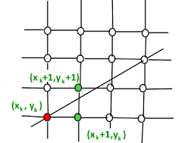
Lecture 4
Bresenham Line Drawing Algorithm
Prepared by Tapasy Rabeya Senior Lecturer CSE, DIU | Course Teacher Nushrat Jahan Oyshi Lecturer CSE, DIU
Department of CSE, Daffodil International University
Notes:
‹#›

Slide 2
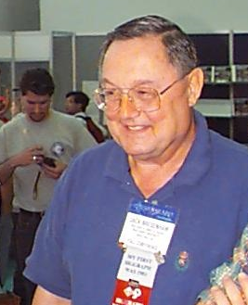
The Bresenham Line Algorithm
The Bresenham algorithm is another incremental scan conversion algorithm
The big advantage of this algorithm is that it uses only integer calculations
Jack Bresenham worked for 27 years at IBM before entering academia.
Bresenham developed his famous algorithms at IBM in the early 1960s.
Department of CSE, Daffodil International University

Slide 3
The Big Idea
Move across the x axis in unit intervals and at each step choose between two different y coordinates
5
For example, from position (2, 3) we have to choose between (3, 3) and (3, 4)
We would like the point that is closer to the original line
(x_{k}+1, y_{k}+1)
4
(x_{k}, y_{k})
3
(x_{k}+1, y_{k})
2
2
3
4
5
Department of CSE, Daffodil International University
‹#›

Slide 4
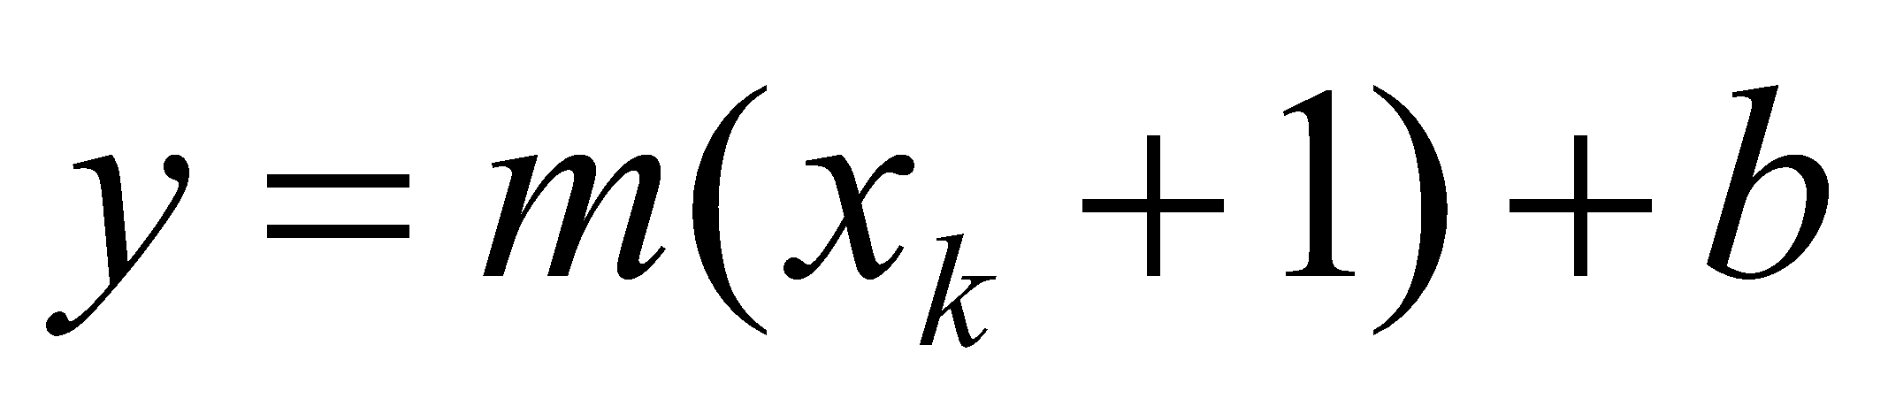
Deriving The Bresenham Line Algorithm
Considering, |m| < 1
At sample position x_{k}+1 the vertical separations from the mathematical line are labelled d_{upper} and d_{lower}
y_{k+1}
d_{upper}
y
d_{lower}
y_{k}
x_{k}+1
The y coordinate on the mathematical line at x_{k}+1 is:
Department of CSE, Daffodil International University
‹#›

Slide 5
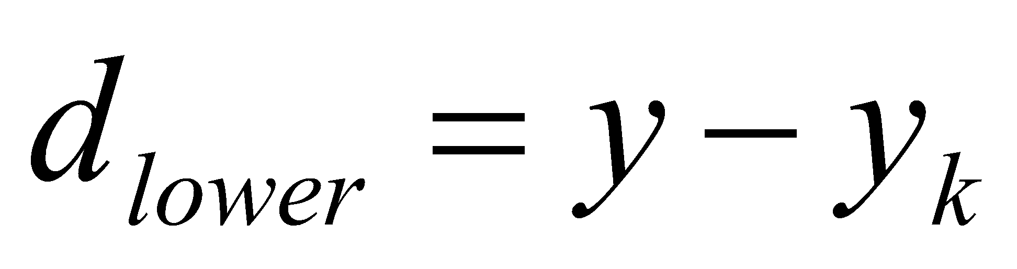
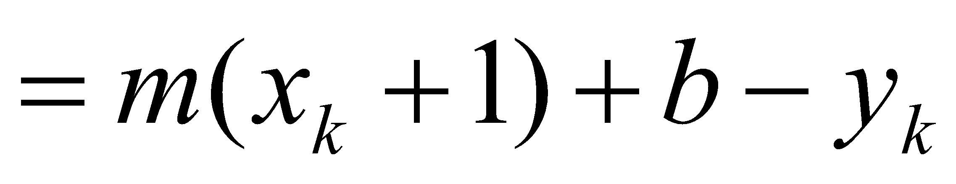
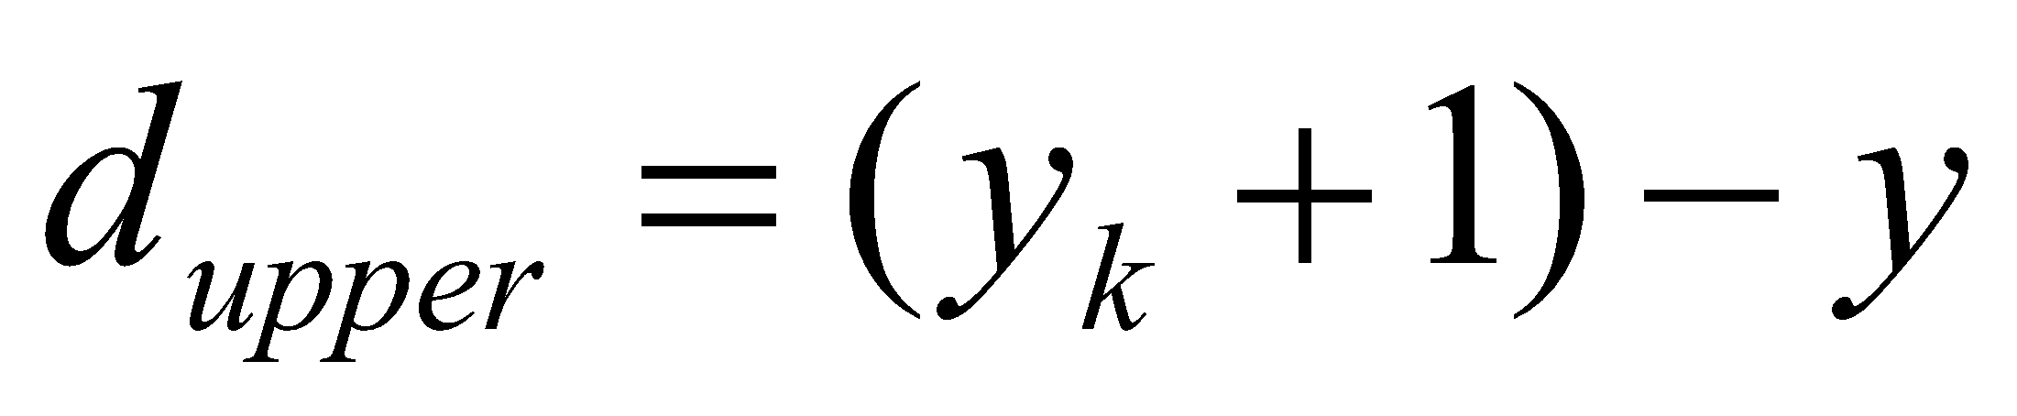
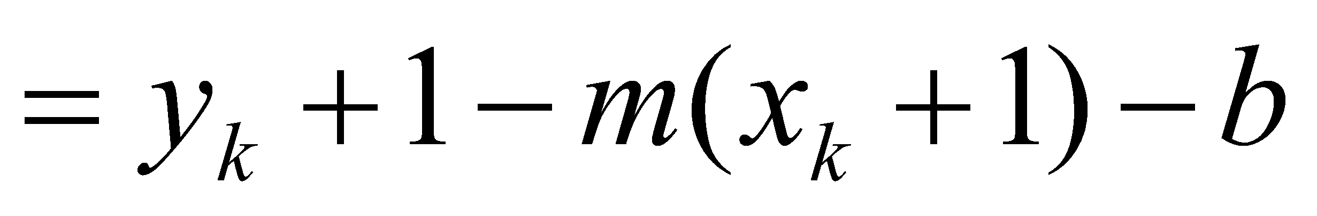
Deriving The Bresenham Line Algorithm
So, d_{upper} and d_{lower} are given as follows:
and
We can use these to make a simple decision about which pixel is closer to the mathematical line
Department of CSE, Daffodil International University
‹#›

Slide 6
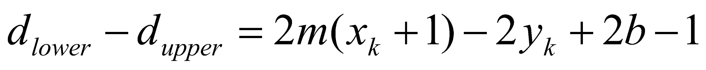
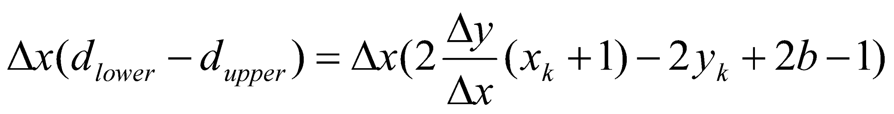
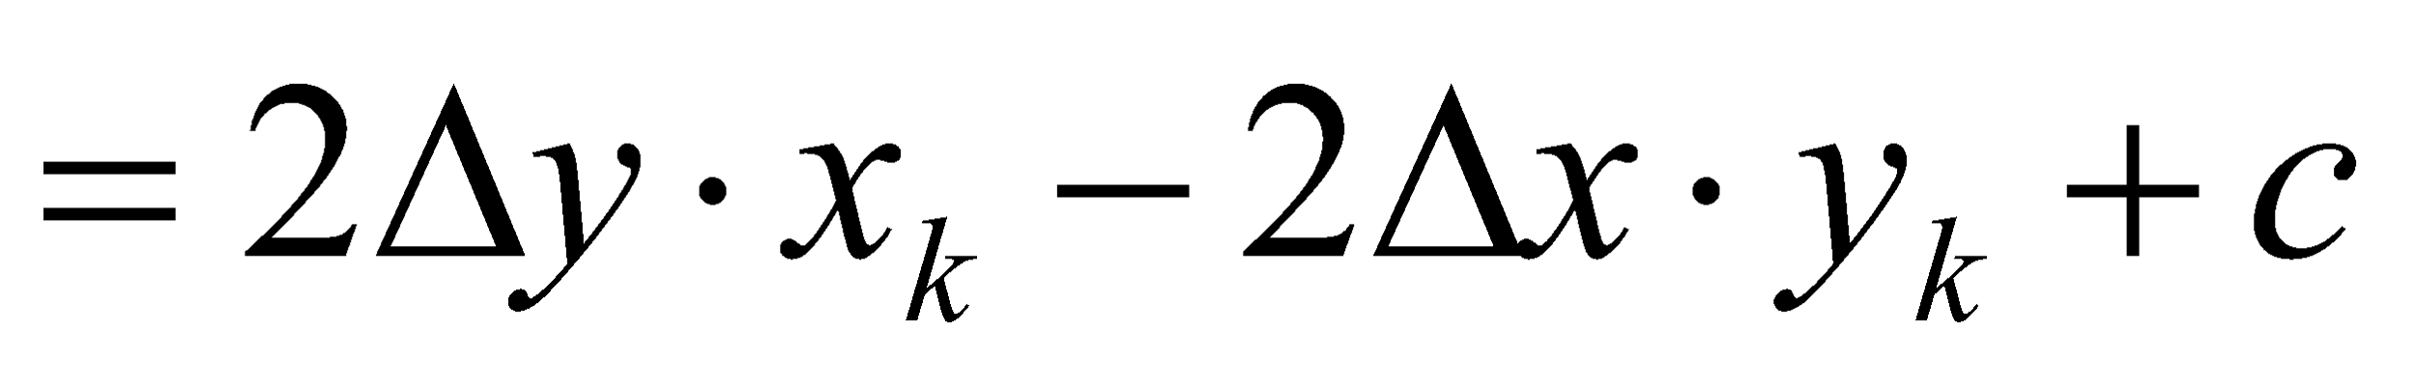
Deriving The Bresenham Line Algorithm
This simple decision is based on the difference between the two pixel positions:
Let’s substitute m with ∆y/∆x where ∆x and ∆y are the differences between the endpoints:
Department of CSE, Daffodil International University
‹#›

Slide 7
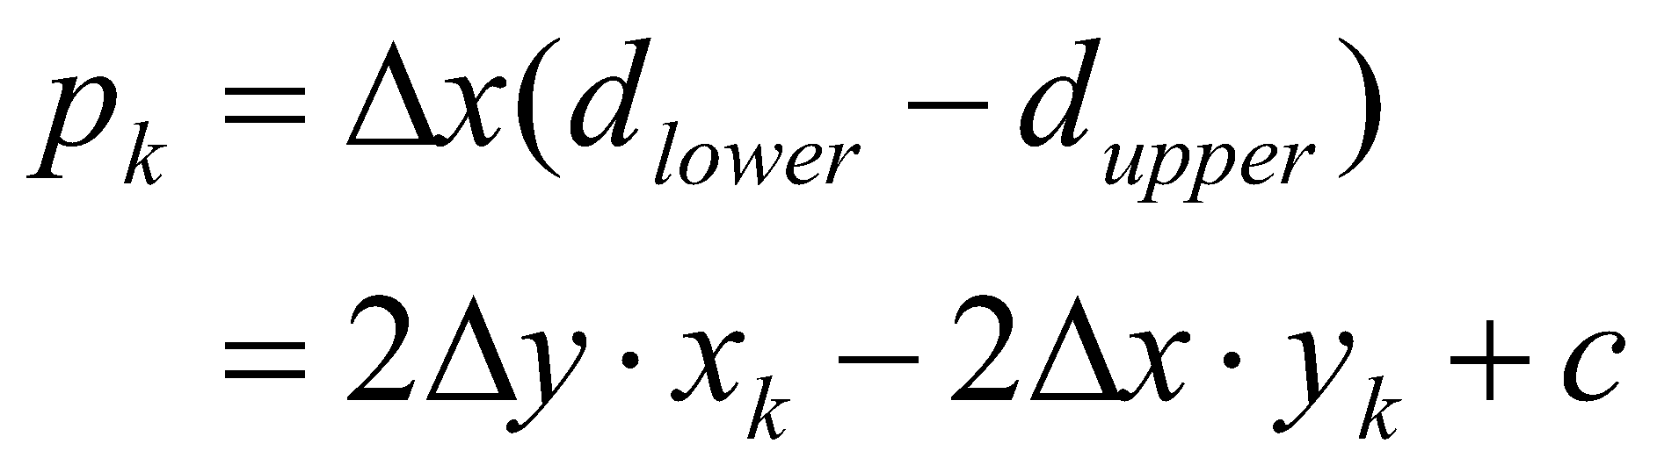
Deriving The Bresenham Line Algorithm
So, a decision parameter p_{k} for the kth step along a line is given by:
The sign of the decision parameter p_{k} is the same as that of d_{lower} – d_{upper}
If p_{k} is negative, then we choose the lower pixel, otherwise we choose the upper pixel
Department of CSE, Daffodil International University
‹#›

Slide 8
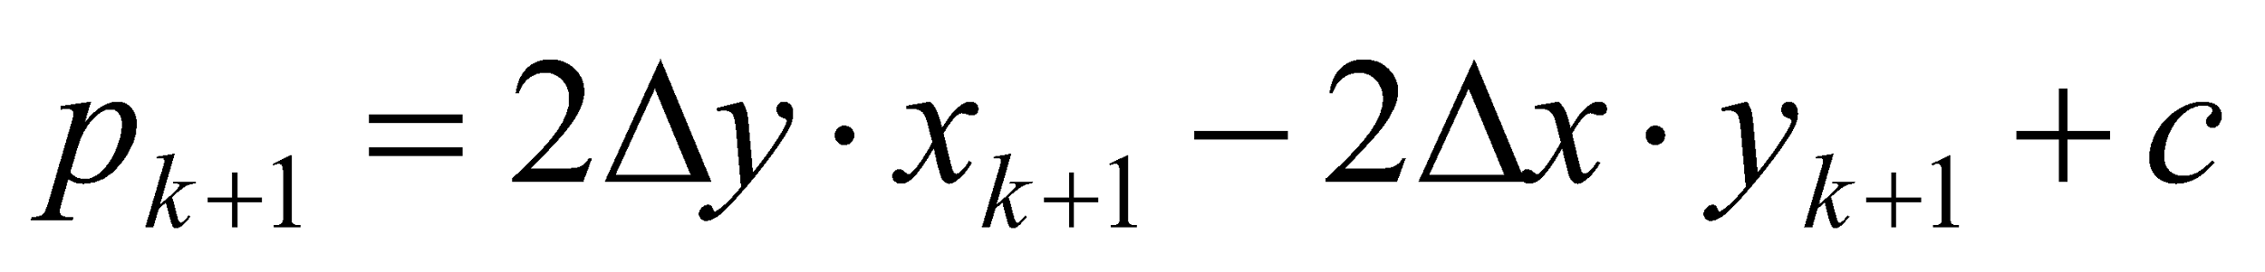


Deriving The Bresenham Line Algorithm
Remember coordinate changes occur along the x axis in unit steps so we can do everything with integer calculations
At step k+1 the decision parameter is given as:
Subtracting p_{k} from this we get:
here,
[ ]
Department of CSE, Daffodil International University
‹#›

Slide 9
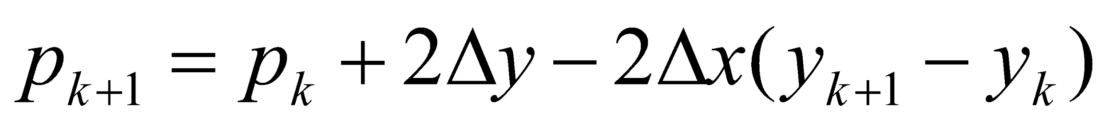
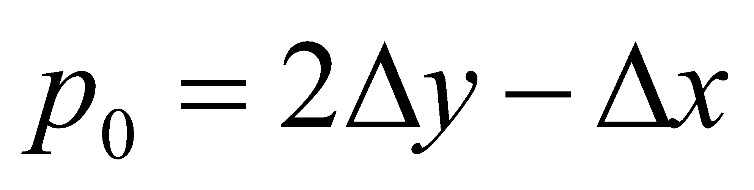
Deriving The Bresenham Line Algorithm
But, x_{k+1} is the same as x_{k}+1 so:
where y_{k+1} - y_{k} is either 0 or 1 depending on the sign of p_{k}
The first decision parameter p0 is evaluated at (x0, y0) is given as:
Department of CSE, Daffodil International University
‹#›

Slide 10
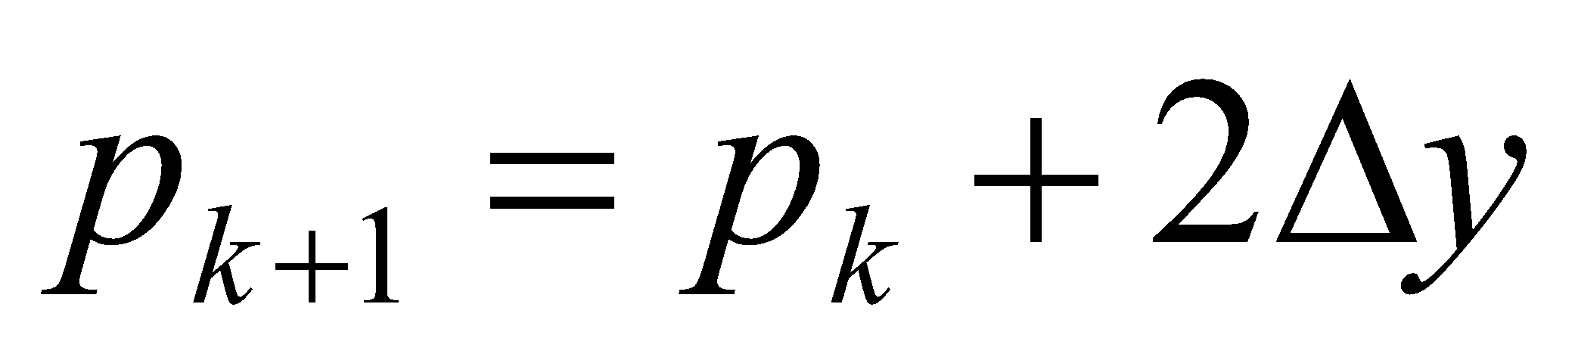
Bresenham’s Line Algorithm
BRESENHAM’S for |m| < 1
1. Input the two line end-points, storing the left end-point in (x₀, y₀)
2. Plot the point (x₀, y₀)
3. Calculate the constants Δx, Δy, 2Δy, and (2Δy - 2Δx) and get the first value for the decision parameter as:
4. At each x_{k} along the line, starting at k = 0, perform the following test. If p_{k} < 0, the next point to plot is (x_{k}+1, y_{k}) and
‹#›

Slide 11
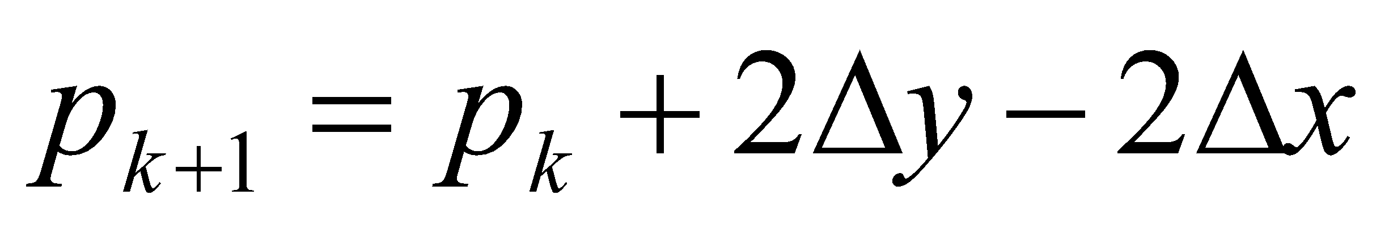
The Bresenham Line Algorithm (cont..)
Otherwise, the next point to plot is (x_{k}+1, y_{k}+1) and:
5. Repeat step 4 (Δx – 1) times
Attention! The algorithm and derivation above assumes slopes are less than 1. for other slopes we need to adjust the algorithm slightly.
Department of CSE, Daffodil International University
‹#›

Slide 12
Bresenham’s Line Algorithm
BRESENHAM’S for |m| > 1
Resource: https://getsetcg.blogspot.com/2018/10/bresenham-line-drawing-derivation.html
‹#›

Slide 13
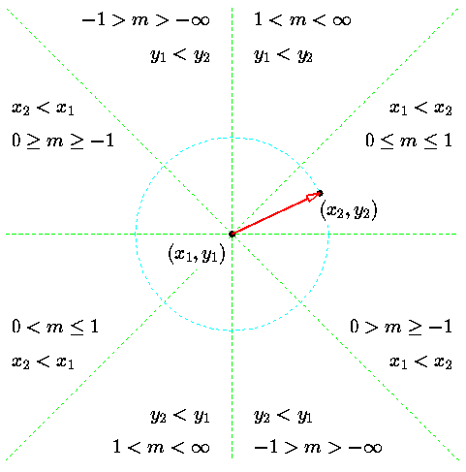
The Bresenham Line Algorithm (cont..)
Department of CSE, Daffodil International University
‹#›

Slide 14
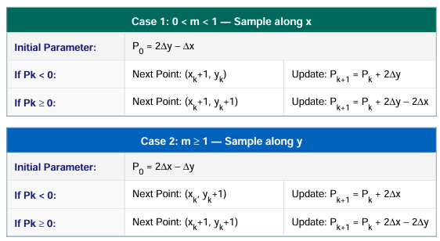
The Bresenham Line Algorithm (cont..)
Department of CSE, Daffodil International University
‹#›

Slide 15
Example
Calculate the points between the starting point (20, 10) to the ending point (30, 18).
First off calculate all of the constants:
Δx: 10
Δy: 8
2Δy: 16
2Δy - 2Δx: -4
Calculate the initial decision parameter p₀:
p0 = 2Δy – Δx = 6
Department of CSE, Daffodil International University
‹#›

Slide 16
Example
18
17
16
15
14
13
12
11
10
20
21
22
23
24
25
26
27
28
29
30
Department of CSE, Daffodil International University
‹#›

Slide 17
Example
k | p_{k} | (x_{k+1},y_{k+1})
0 1 2 3 4 5 6 7 8 9 10 | p0 =6 p1 =2 p2= -2 p3=14 p4=10 p5 = 6 p6 = 2 p7= -2 p8=14 p9=10 p10=6 | (20,10) (21,11) (22,12) (23,12) (24,13) (25,14) (26,15) (27,16) (28,16) (29,17) (30,18)
Department of CSE, Daffodil International University
‹#›

Slide 18
Example
Go through the steps of the Bresenham line drawing algorithm for a line going from (21,12) to (29,16)
k | p_{k} | (x_{k+1},y_{k+1})
0 1 2 3 4 5 6 7 8 | p0 = 0 p1 = -8 p2 = 0 p3 = -8 p4 = 0 p5 = -8 p6 = 0 p7 = -8 p8 = 0 | (21,12) (22,13) (23,13) (24,14) (25,14) (26,15) (27,15) (28,16) (29,16)
Department of CSE, Daffodil International University
‹#›

Slide 19
Example
18
17
16
15
14
13
12
11
10
20
21
22
23
24
25
26
27
28
29
30
Department of CSE, Daffodil International University
‹#›

Slide 20
Home work
Go through the steps of the Bresenham line drawing algorithm for a line going from (4,8) to (14,22)
Go through the steps of the Bresenham line drawing algorithm for a line going from (8,7) to (3,13)
Department of CSE, Daffodil International University
‹#›

Slide 21
Bresenham Line Algorithm Summary
The Bresenham line algorithm has the following advantages:
A fast incremental algorithm
Uses only integer calculations
Comparing this to the DDA algorithm, DDA has the following problems:
Accumulation of round-off errors can make the pixelated
line drift away from what was intended
The rounding operations and floating point arithmetic
involved are time consuming
Department of CSE, Daffodil International University
‹#›
Notes:
‹#›

Slide 22

Department of CSE, Daffodil International University
‹#›
Notes:
‹#›

